Slide 1
Boosting WPF Performance
Creating High Performance Desktop Applications
Ashish Kumar Singh
Notes:
“Hello, everyone! I’m Ashish Singh, a Senior Engineer with Microsoft’s WPF team. I’m excited to discuss how you can harness WPF to create high-performance apps that maximize resource efficiency and deliver a seamless experience for users.”
WPF's robust architecture and versatility make it a trusted framework for building enterprise-grade applications. It empowers developers to create feature-rich, responsive applications that meet modern business demands.

Slide 2
Agenda
01
02
03
Memory Debugging
Investigation and Tips
WPF Perf Improvements in .NET9
Notes:
“Today, we’ll focus on three main areas: memory debugging, practical WPF performance tips, and the latest WPF performance improvements in .NET 9.”
“Whether you’re troubleshooting performance bottlenecks or looking to improve your app’s performance, these insights should give you actionable steps to enhance WPF app performance.”

Slide 3
01
Memory Debugging
Notes:
“Let’s start with memory debugging. Memory management is often the backbone of app performance, as memory-related issues can lead to resource saturation, lags, or even app crashes with OOM.”

Slide 4
Memory Debugging
Impacts Performance
Too Many Allocations
Object Lifetime
Object Pinning
Memory Leaks
Cache Management
Out-Of-Memory
Resource Saturation
Notes:
When debugging memory issues in .NET applications, it's important to understand the two main types of memory problems:
Performance-Related Issues:
Too Many Allocations: Excessive allocations can degrade performance.
Object Lifetime Issues: Inefficient object lifetimes can lead to excessive garbage collection.
Object Pinning: Pinned objects can hinder the garbage collector’s efficiency.
Memory Resource Saturation:
Memory Leaks: Unreleased memory that continues to grow over time.
Cache Management Issues: Inefficient cache usage leading to excessive memory consumption.
Heap Fragmentation: Memory becomes fragmented, leading to inefficient memory use.
Out-of-Memory Exceptions: Application runs out of available memory.
Understanding and identifying these problems is the first step in effectively addressing memory issues in your .NET applications.

Slide 5
Memory Debugging
METRIC
MEASURE
TRACE
01
02
03
DEBUG & ANALYZE
IMROVE
REPEAT
04
05
06
Notes:
When it comes to debugging memory issues in .NET applications, a structured approach is key. Let’s break it down:
Decide What Matters:
Focus on critical performance metrics like latency, throughput, and CPU usage.
Make It Measurable:
For latency and throughput, use EventSource start/stop events or platform-level events.
For CPU usage, leverage performance counters and ETW traces.
Capture a Trace:
Use tools like PerfView, Windows Performance Analyzer (WPA), or Perfcollect to gather detailed performance data.
Analyze, Improve, Repeat:
Analyze the collected data to identify bottlenecks.
Implement improvements based on your findings.
Repeat the tracing and analysis to ensure your changes have the desired effect.
Finally, always target the metrics that matter most to your application’s performance. This focused approach will help you effectively debug and optimize your .NET applications.

Slide 6
02
XPS Printing – Memory Leak Investigation
Notes:
In this section we will be investigating a memory leak in XPS Printing. A leak here could cause applications that use printing extensively to consume excessive memory

Slide 7
03
WPF Performance Tips

Slide 8
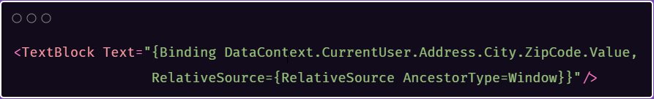
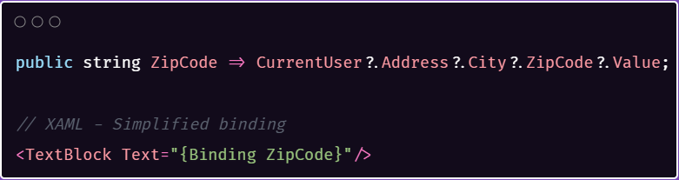
Tip 1: Binding Path Optimization
Notes:
When you create a binding path in WPF, it might look harmless at first. However, WPF creates property change subscriptions for each object in the binding path. This means that if any object in this chain changes, WPF has to re-evaluate the entire path. This process creates unnecessary overhead because WPF is monitoring multiple objects and their properties, which can lead to performance issues and potential memory leaks.
The solution to this problem is straightforward and effective. By reducing the number of binding subscriptions, you can make your code more maintainable and easier to debug. This approach also allows you to include additional logic if needed, making your application more efficient. Optimizing the binding path helps in enhancing the overall performance and efficiency of your WPF application by minimizing unnecessary updates and resource usage.

Slide 9
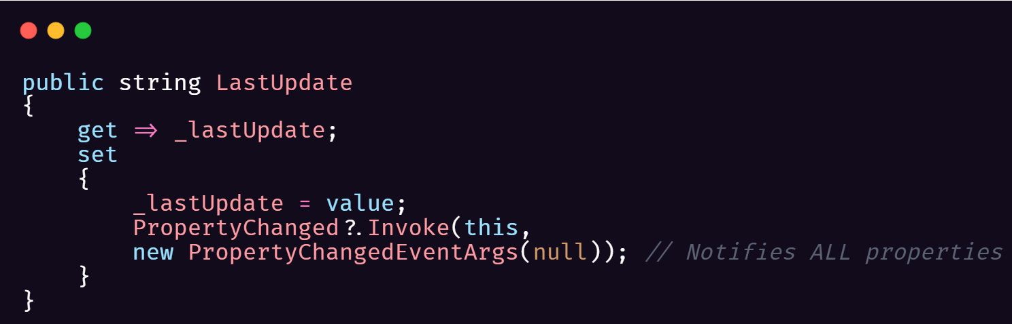
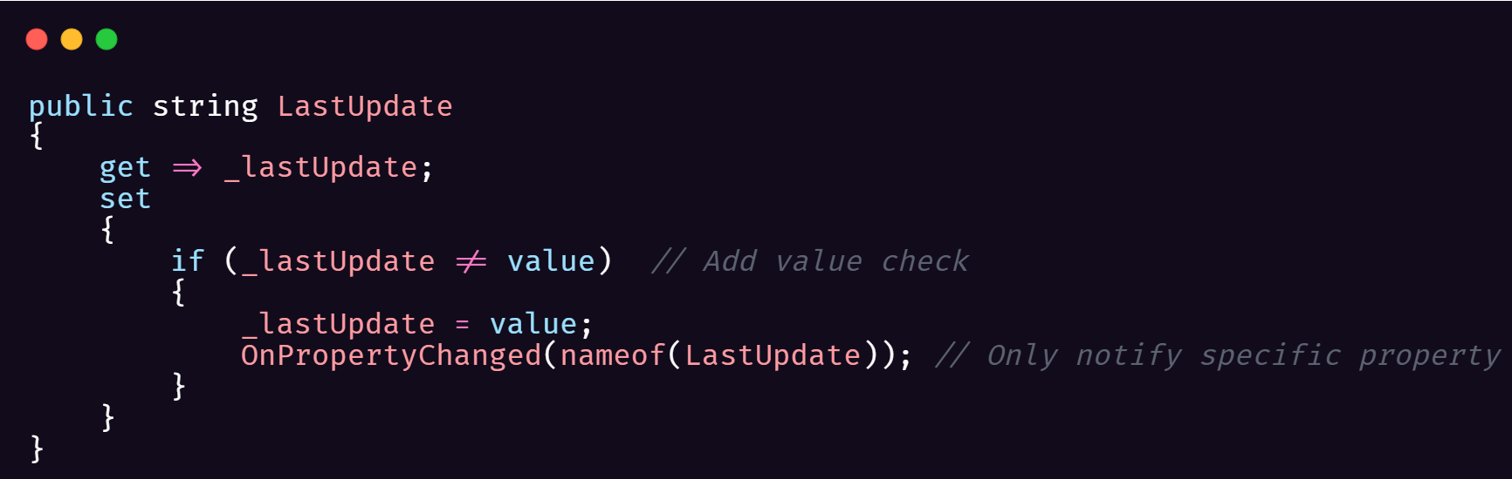
Tip 2: Property Change Notifications
Notes:
When developers notify WPF of changes in a way that suggests everything has changed, it causes WPF to update the entire UI. This is inefficient because it consumes more processing power and resources than necessary. Essentially, WPF is doing more work than it needs to, which can slow down the application and lead to a poor user experience. By being specific about what has changed and only notifying WPF about the exact property that has been updated, we can avoid these unnecessary updates. This targeted approach ensures that only the relevant parts of the UI are refreshed, leading to better performance and a smoother user experience.

Slide 10
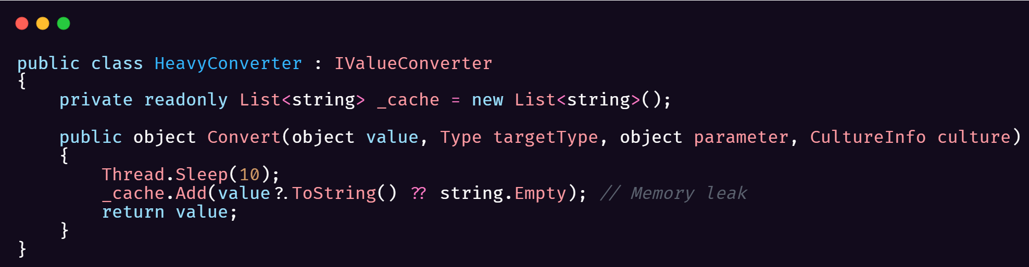
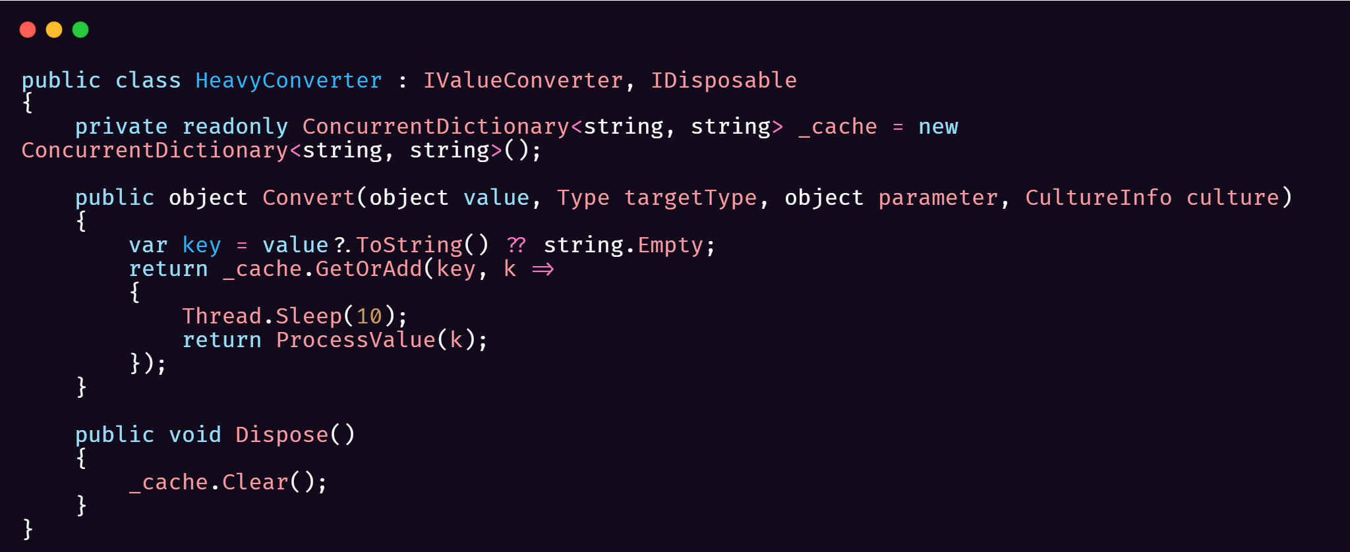
Tip 3: Caching
Notes:
"Converters are incredibly useful in WPF, but if not implemented correctly, they can severely impact performance. Common issues include:
Memory leaks due to an ever-growing cache
Repeatedly performing expensive operations
Failing to clean up resources
To address these issues, let's look at an optimized converter:
Implement IDisposable to ensure proper resource cleanup
Use a thread-safe ConcurrentDictionary for caching to enhance efficiency
These optimizations help manage resources efficiently and improve overall performance."

Slide 11
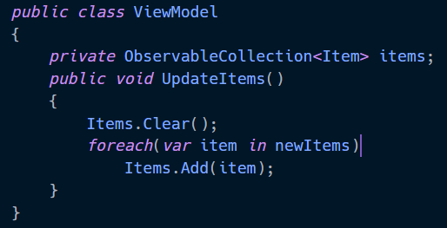
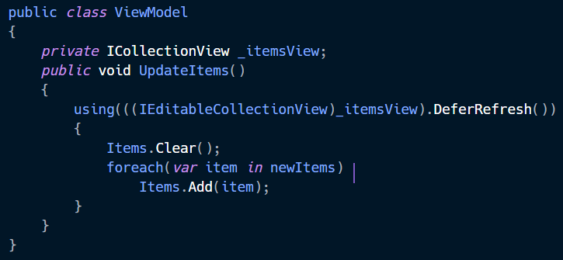
Tip 4: Batch Updates
Notes:
"When updating collections in WPF, each individual change can cause a UI refresh. This can lead to excessive UI updates and degrade performance.
For example, if we update a collection without batching, each modification triggers a separate UI update, which is inefficient.
Instead, we can batch our updates using DeferRefresh. This approach postpones all UI updates until the using block completes, significantly reducing the number of updates.
Although these optimizations might seem minor on their own, when combined, they can greatly enhance your application's performance."

Slide 12
04
WPF performance - .NET9 and Beyond

Slide 13
.NET9 Perf Improvements
Reduced allocations with ReadOnlySpan<T>
@h3xds1nz
Improved DynamicResource Usage
@batzen
Reduced Reflection
@lindexi

Slide 14
WPF Performance Roadmap
Performance in Focus
Prioritize Community PRs on Performance
Add/Improve Perf Testing Infra
Notes:
Our future plans include ongoing performance enhancements, the expansion of our performance testing infrastructure, and a dedicated effort to consistently improve WPF. With the community's valuable feedback and contributions, we aim to continually elevate WPF's performance standards.

Slide 15
Thank you
Notes:
“Thank you all for joining! We’re excited about what you can create with the latest WPF improvements in .NET 9, and we encourage you to try them out.”
“Please connect with us on GitHub if you have any questions, suggestions, or want to contribute further. Your feedback is invaluable, and we’re eager to keep making iterative progress together.”
“Thanks again to the highly active and engaged wpf community for all the support. Let’s continue building high-performance WPF applications!”

